Slide 2
What is Thrifting??
Thrifting or thrift shopping is the practice of purchasing secondhand or used items from stores, either physical or online.

Slide 3
Why am I credible to speak on thrifting?
Alyssa Gray= Passionate thrifter
70% of my closet/house is thrifted
I thrift ATLEAST one time a week
I thrifted a real Prada bag.

Slide 4
Why Should You Thrift??
Four Positive Effects of Thrifting!!
01
02
03
04
Help the community and charities!
Help the environment!!
Better your Mental Health!
Save Money!!

Slide 5
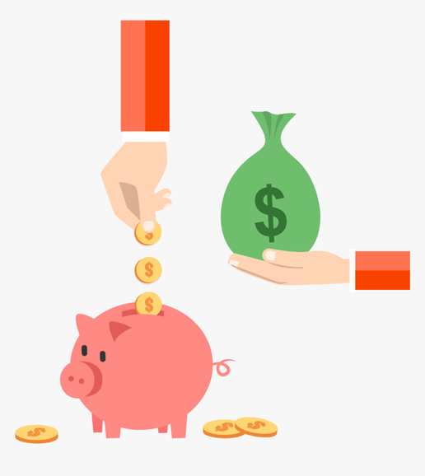
1. Save Money!
Thrift shoppers save nearly $150 a month, or $1,760 a year, on average, report by CouponFollow
Save money on everyday items- shirt, shoes, couch, even a car
GET $$$ - RESELL, UPCYCLE, REPURPOSE

Slide 6
2. Help the Environment!
Thrifting keeps clothes out of landfills longer
Reduces carbon and chemical pollution caused by clothing production, and lowers water consumption
Make the switch from fast fashion to thrifting- guilt free alternative

Slide 7
3. Help the Community!
Thrifting lowers unemployment rates by creating more jobs
Allows for a place to receive clothing for a lower price making it more accessible
Most thrift stores also support local charities

Slide 8
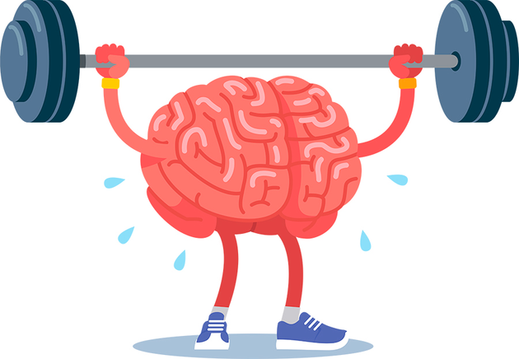
4. Benefits your Mental Health!
Endorphins are released and improve your overall mood when you have the exciting moments like finding THE perfect item.
Supports CREATIVITY which can increase positive emotions and reduce depressive symptoms and anxiety
Thrift shopping can also be a physical and mental exercise!

Slide 9
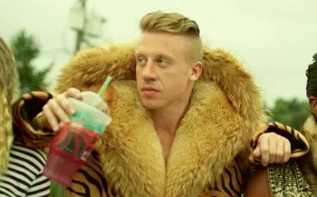
Too cool to thrift?
DONATE!
Keep your home clutter-free
Protect the planet
Help others in your community
More for ME!

